Slide 1
COMMUNICATION BETWEEN MULTIPLE PROCESSES ON SAME DEVICE USING TCP/IP SUITE
SAILESH PANDEY(1NT18CS201)
MANAN VANAWAT(1NT18CS091)

Slide 2
INTRODUCTION
TCP/IP protocol suite is a set of protocols used at different layers, for governing communication between multiple processes.
It is an established fact that the data transmission between two devices or processes is achieved via packets, according to the rules and regulations of TCP/IP protocol suite.
The said transmission involves all the layers of TCP/IP protocol suite. The different processes involved in the transmission follow the same rule of the TCP / IP suite either on the same device or on different devices.
In this paper, we proposed an algorithm with the help of which the data is being transmitted from one process to another process using the same file if both processes are on the same device. Our proposed algorithm uses only the two top layers, i.e., Application and Transport, of a TCP/IP protocol suite while, the rest of the layers, i.e., Network, Data Link and Physical, are not used.

Slide 3
The data is transferred directly from the transport layer of one process to the transport layer of the other process.
The proposed algorithm saves a significant amount of computational power and other system resources that are consumed by the lower layers, i.e., Network, Data Link and Physical.
Vint Cerf and Bob Kohn developed it in 1978.
According to TCP/IP protocol suite, the data are divided into small fragments, also known as packets.
These packets contain the data and addresses of the source and destination for communication among endpoints
The UDP protocol is one of the most frequently used connectionless protocols implemented at transport layer.
The IP addresses of communicating devices and port numbers of the communicating processes are used as the source and destination addresses

Slide 4
To solve this problem, they have developed an algorithm that minimizes the consumption of resources, i.e., only a subset of resources is used.
To this end, the algorithm uses resources pertaining only to the first two top layers, i.e., application and transport.
The aim of the algorithm is to skip the extra layers, i.e., Network, Data Link and Physical, of a TCP/IP protocol suite.
The IP addresses of the sender and receiver will be compared to check whether both processes are on the same device or not. If both processes are on the same device, then the sender will write the target data in a file and from that file receiver will retrieve the required data.
The proposed algorithm provides a better speed and less use of system resources if both processes are on the same device.

Slide 5
Conventional communication between processes using TCP/IP
Packets are transmitted by sockets using long route.
The destination of packets is either the same device or other devices.
This route consists of all layers of TCP/IP protocol suite, the involved medium between computers and router and, all the layers of the router.
This route is perfect if both sender and receiver processes are on different devices .
If source and destination are on the same device, then the previously mentioned route is a waste of time and resources.
Based on this condition, the optimal path for transferring packets is the direct connection between the transport layer of source process and transport layer of destination process.

Slide 6
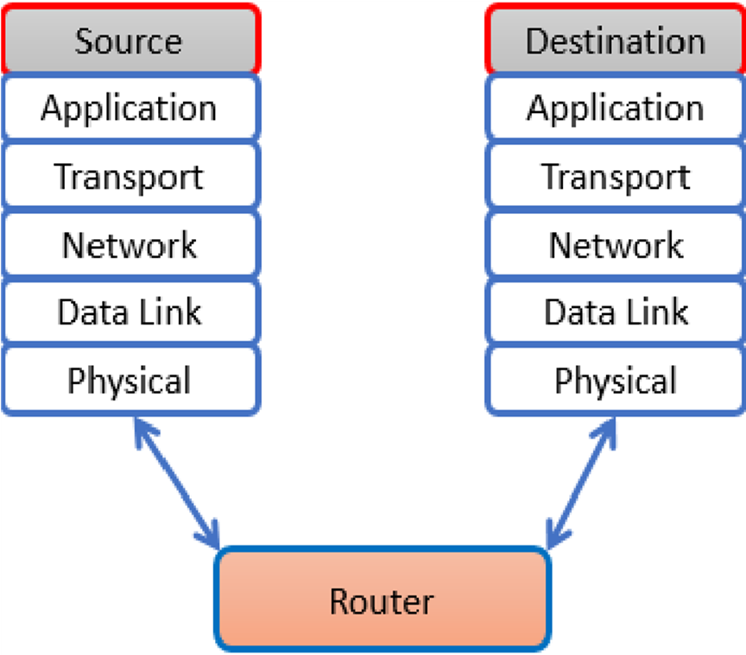
Conventional communication between processes using TCP/IP

Slide 7
Proposed Solution
In this paper, they have developed an algorithm, which transfers packets directly from the transport layer of source to transport layer of destination process, if both processes are on the same device.
They used transport layer because transport layer is responsible for process-to-process packet delivery.
Through this algorithm, they skipped three layers of TCP/IP suite on computer, medium connecting router and computer and all layers of the router. If source and destination are on different devices, then the packet will follow its default path.
Initially, IP addresses of both sender and receiver are compared to check whether both processes are on the same device or not.
If IP addresses are different then default path will be followed for packet transmission otherwise, our newly proposed path will be followed.
The short path will be followed through our newly developed algorithm.

Slide 8
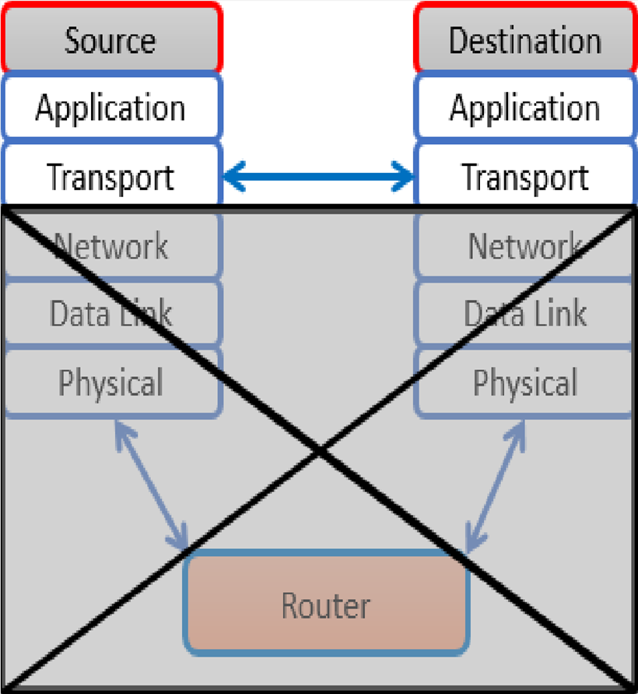

Slide 9
SEND PROCESS ALGORITHM
1.If ( IPAddress == LocalIPAddress) then
2. Path <- “C:\tmp\” + LocalPort
3. SendData <- open( Path , Write )
4. Write (SendData , Packet.Data , size)
5. Close ( SendData )
6.Else
7. Run default Send Code
8.End if

Slide 10
This algorithm will take data from each packet at sender side and write it to a file as shown in Algorithm of send process. The receiver needs to know the location and name of the file. The receiver will retrieve data from the file created by the sender and copies it to a packet using thread containing our newly proposed algorithm.
In Algorithm of send process, we used an IP address to check whether the destination program is on the same device or other device. For this purpose, we compared IP address in the packet to the local IP address.
If the IP addresses do not match, data will be passed to a target device using default socket rules.
If the IP addresses are matched, a new file will be created in C:\tmp\ directory whose name will be port number of current processes.
We used port number as file name so that on a receiver side port number of source process can be retrieved. The said directory will also be created if it does not exist.

Slide 11
A System Call will be used to open the newly created file. The new file must be opened with writing privileges.
Another System Call will be used to take data from packet and write it in the above-mentioned file. The file must be locked during this process so that data should not be manipulated.
After doing all these steps, the file will be closed and all its privileges will be released. After this, the receiver side program will retrieve data in the above-mentioned file.
At the receiver side, we split the receiving process into two threads. One thread will wait for data from socket according to the previous rules. The second thread will retrieve data from the file created by the sender process.

Slide 12
RECEIVE PROCESS AGORITHM
1. DiffDeviceThread
2. Run default receive code
3. End DiffDeviceThread
4. SameDeviceThread
5. FileExist ßFalse
6. Path ß “C:\tmp\”
7. AgainLabel
8. Files[ ] ßPath.ListFiles
9. Foreach FS as Files
10. If ( FS.isInteger )
11. Path = Path + FS
12. FileExist ßTrue
13. Exit Foreach
14. End If
End Foreach
If ( !FileExist )
17. Goto AgainLabel
18. End If
19. While ( !Path.CanWrite )
20. End While
21. ReceiveData ßopen (Path , Read&Write)
22. Read (ReceiveData , Packet.Data , size )
23. FileName ßPath.getFileName
24. Packet.Port ß FileName
25. Packet.IPAddress ßLocalIPAddress
26. Delete File
27. Close ReceiveData
28. End SameDeviceThread
29. Start SameDeviceThread
30. Start DiffDeviceThread
31. If(SameDeviceThread or DiffDeviceThread Completes)
32. Stop SameDeviceThread
33. Stop DiffDeviceThread
34. End If

Slide 13
At the receiver side, we split the receiving process into two threads. One thread will wait for data from socket according to the previous rules. The second thread will retrieve data from the file created by the sender process.
In the second thread, we will declare a string with directory address containing the target file. Next, we will retrieve all file names from the directory and save it in an array, named as “Files” in Algorithm 2.
Next, we used a foreach loop to check the whole array to find a file whose name is just an integer. We used this statement because the name of the file created by sender process is the port number of the sender process and port number is always an integer. If any file with integer name is found, then the value of Boolean variable FileExist will change to true and the file name will be added to the path string.
Next, we check the value of the variable FileExist, if it is true, the program will proceed to next statement otherwise, and it will go back to the statement where directory files are saved in an array. This process will be performed using GOTO labels.

Slide 14
Now, we will check if the file can be opened using while loop. If the file is opened by another process, the while loop will continue looping until the said file is released. After this, the file will be opened using System Call with full privileges. The data from the file will be retrieved using the System Call and added to packet data.
Now, we will retrieve file name from the path and add it as the port number to the receiving packet.
Local IP Address will be added to the packet as its IP Address.
After this, the file will be deleted permanently which was used for data transferring and the open function variable will be closed.
When a receiving function is called, it will start the two aforementioned threads. These threads will continue to work until their completion. If any one of the two threads complete its function then, the function will close the other thread.

Slide 15
CONCLUSION
The paper focused on the problems associated with process-to-process delivery of data on a single device. Traditionally, process-to-process delivery in TCP/IP protocol involves all the layers, which results in extra resource consumptions in terms of bandwidth, computational power, memory and other QoS parameters. In addition, the process-to-process delivery results in higher latency and jitter.
We presented a scheme, which bypassed the lower layers of the TCP/IP protocol. Our proposed scheme consists of two algorithms, which operates only for the two upper layers. Our proposed scheme used UDP protocol for direct transmission of information between two processes.

Slide 16
Future Work
Currently, they are working towards the
implementation of their proposed algorithms using JDK
headers. They aim to improve the efficiency and accuracy of data transfer between multiple processes running on a single host.

Slide 17
THANK YOU

